Slide 1
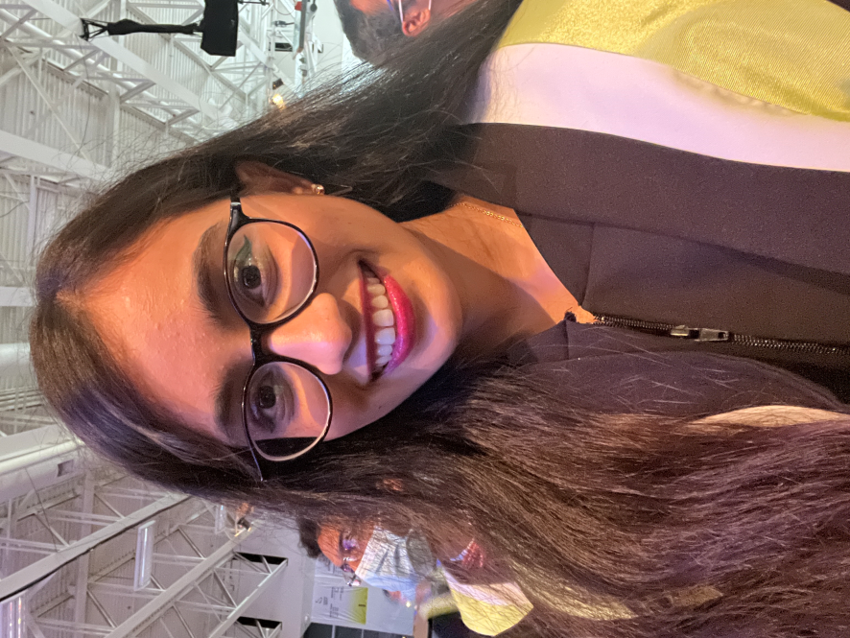
Presented By
MAPD 714 – iOS Development
Mid-Term Test
Simple Shopping List App
Apeksha Parmar
301205325

